Slide 1
Computer Instructions
Control Unit with Timing,
Instruction Cycle and
Determine the Type of Instruction

Slide 2
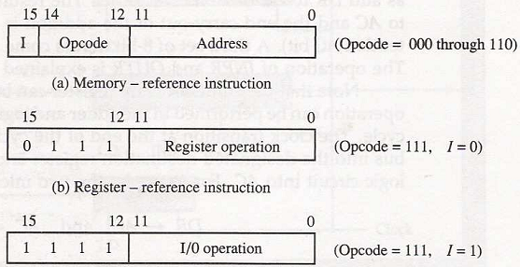
Computer Instructions
Fig: Basic Computer Instruction code format

Slide 3
Computer Instructions
Each format has 16 bits.
The operation code (opcode) part of the instruction contains three bits and the meaning of the remaining 13 bits depends on the operation code encountered.
A memory-reference instruction uses 12 bits to specify an address and one bit to specify the addressing mode I. I is equal to 0 for direct address and to 1 for indirect address.

Slide 4
Computer Instructions
The register-reference instructions are recognized by the operation code 111 with a 0 in the leftmost bit (bit 15) of the instruction. A register-reference instruction specifies an operation on or a test of the AC register. An operand from memory is not needed; therefore, the other 12 bits are used to specify the operation or test to be executed.
An input-output instruction does not need a reference to memory and is recognized by the operation code 111 with a 1 in the leftmost bit of the instruction. The remaining 12 bits are used to specify the type of input-output operation or test performed.

Slide 5
Basic Computer Instructions
The type of instruction is recognized by the computer control from the four bits in positions 12 through 15 of the instruction.
Memory-reference: If the three opcode bits in position 12 through 14 are not equal to 111.
Bit 15 is taken as the addressing mode I.
If the 3 bits opcode is equal to 111, control then inspects the bit in position 15.
Register-reference: If 15 bit is 0.
Input-output: If 15 bit is 1.

Slide 6
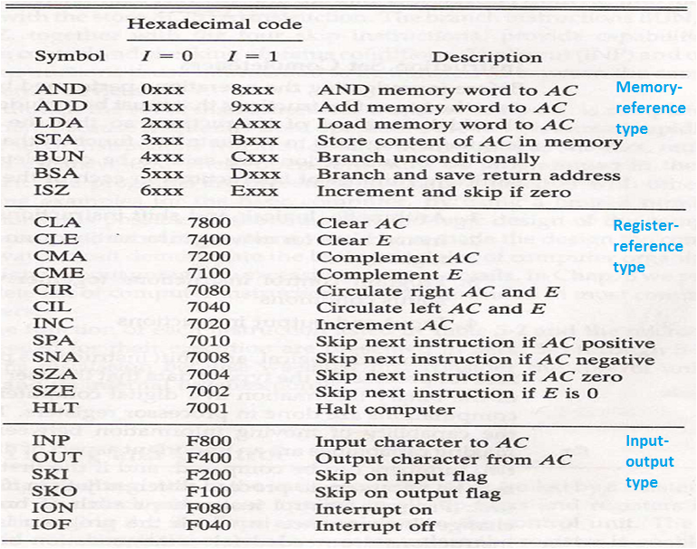
Basic Computer Instructions

Slide 7
Basic Computer Instructions
The 16 bits of an instruction code is reduced to equivalent four digits hexadecimal digits.
Memory-reference: the address part is denoted by three x’s and stand for the three hexadecimal digits.
Register-reference: The leftmost four bits are always 0111, which is equivalent to hexadecimal 7.
Input-output: The last four bits are always 1111, equivalent to hexadecimal F.

Slide 8
Control Unit with Timing
The timing for all registers in the basic computer is controlled by a master clock generator.
The clock pulses are applied to all flip-flops and registers in the system, including the flip-flops and registers in the control unit.
The clock pulses do not change the state of a register unless the register is enabled by a control signal (i.e., Load)

Slide 9
Control Unit with Timing
The control signals are generated in the control unit and provide control inputs for the multiplexers in the common bus, control inputs in processor registers, and micro-operations for the accumulator
There are two major types of control organization:
  Hardwired control
  Micro-programmed control

Slide 10
Control Unit with Timing
Hardwired Organization: the control logic is implemented with gates, flip-flops, decoders, and other digital circuits.
Micro-programmed Organization: the control information is stored in a control memory (if the design is modified, the micro-program in control memory has to be updated)

Slide 11
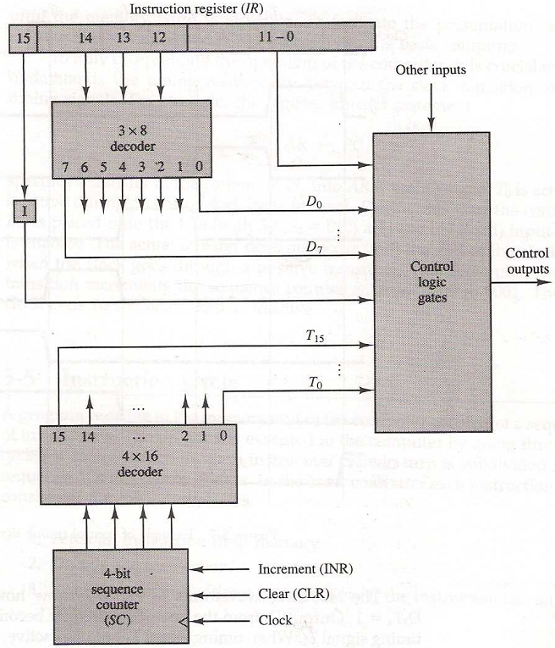
Control Unit of basic computer
Fig: Block diagram of the hardwired control unit

Slide 12
Control Unit of basic computer
It consists of two decoders, a sequence counter, and a number of control logic gates.
An instruction read from memory is placed in the instruction register (IR)
Fig: Block diagram of the hardwired control unit

Slide 13
Control Unit of basic computer
The opcode in bits are decoded with a 3 x 8 decoder. The eight outputs of the decoder are designated by the symbols D₀ through D₇.
Bit 15 of the instruction is transferred to a flip-flop I.
Bits 0 through 11 are applied to the control logic gates.
Fig: Block diagram of the hardwired control unit

Slide 14
Control Unit of basic computer
The 4-bit sequence counter can count in binary from 0 through 15.
The outputs of the counter are decoded into 16 timing signals T₀ through T₁₅.
The sequence counter SC can be incremented or cleared synchronously.
Fig: Block diagram of the hardwired control unit

Slide 15
Control Unit of basic computer
The counter is incremented to provide the sequence of timing signals out of the 4 x 16 decoder.
Fig: Block diagram of the hardwired control unit

Slide 16
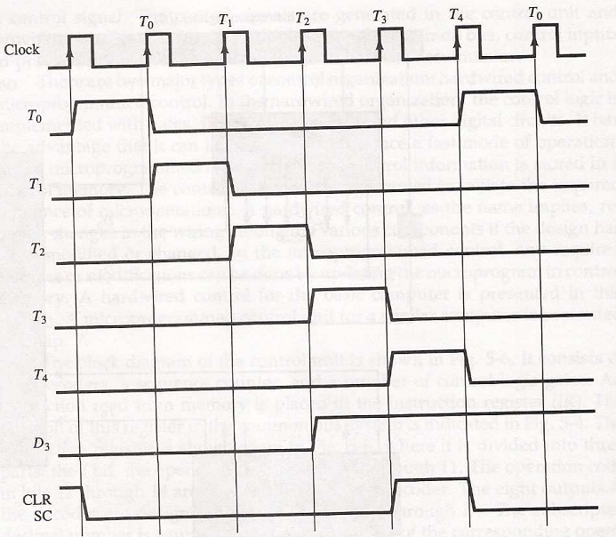
Control Timing Signals

Slide 17
Control Timing Signals
The timing diagram shows the time relationship of the control signals.
The sequence counter SC responds to the positive transition of the clock.
Fig: Diagram of Control Timing Signals

Slide 18
Control Timing Signals
Initially, the CLR input of SC is active. The first positive transition of the clock clears SC to 0, which in turn activates the timing signal T₀ out of the decoder. T₀ is active during one clock cycle.
Fig: Diagram of Control Timing Signals

Slide 19
Control Timing Signals
SC is incremented with every positive clock transition, unless its CLR input is active.
This produces the sequence of timing signals T₀, T₁, T₂, T₃, T₄ and so on, as shown in the diagram.
Fig: Diagram of Control Timing Signals

Slide 20
Control Timing Signals
The last three waveforms in diagram show how SC is cleared when D₃T₄ = 1.
Output D₃ from the operation decoder becomes active at the end of timing signal T₂.
Fig: Diagram of Control Timing Signals

Slide 21
Control Timing Signals
When timing signal T₄ becomes active, the output of the AND gate that implements the control function D₃T₄ becomes active.
This signal is applied to the CLR input of SC. On the next positive clock transition (the one marked T₄ in the diagram) the counter is cleared to 0.
Fig: Diagram of Control Timing Signals

Slide 22
Control Timing Signals
This causes the timing signal T₀ to become active instead of T₅ that would have been active if SC were incremented instead of cleared.
Fig: Diagram of Control Timing Signals

Slide 23
Instruction Cycle
A program is a sequence of instructions stored in memory.
The program is executed in the computer by going through a cycle for each instruction (in most cases).
Each instruction in turn is subdivided into a sequence of sub-cycles or phases.

Slide 24
Instruction Cycle Phases
In the basic computer each instruction cycle consists of the following phases:
  1- Fetch an instruction from memory
  2- Decode the instruction
  3- Read the effective address from memory if the instruction has an indirect address
  4- Execute the instruction
This cycle repeats indefinitely unless a HALT instruction is encountered

Slide 25
Fetch and Decode
Initially, the Program Counter (PC) is loaded with the address of the first instruction in the program.
The sequence counter SC is cleared to 0, providing a decoded timing signal T₀.
After each clock pulse, SC is incremented by one, so that the timing signals go through a sequence T₀, T₁, T₂, and so on.

Slide 26
Fetch and Decode
  T₀: AR←PC (this is essential!!)
  The address of the instruction is moved to AR.
  T₁: IR←M[AR], PC←PC+1
  The instruction is fetched from the memory to IR ,
  and the PC is incremented.
  T₂: D₀,…, D₇←Decode IR(12-14), AR←IR(0-11), I←IR(15)

Slide 27
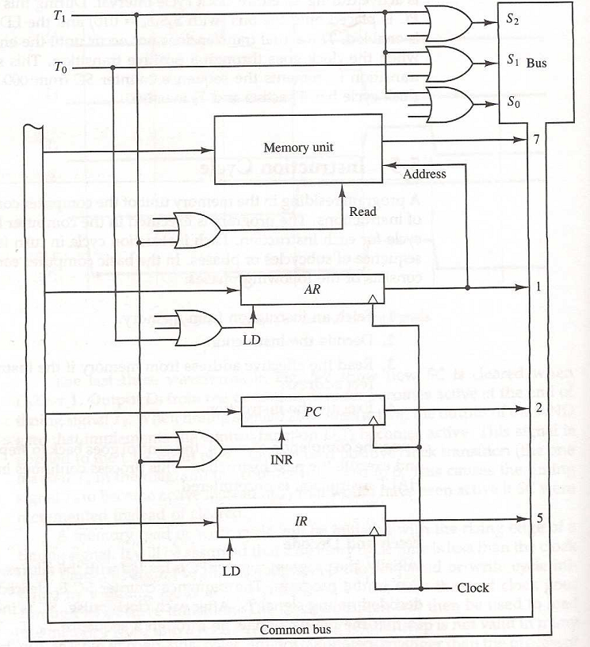
Register transfer for the fetch phase
Fig: Register transfer for the fetch phase.

Slide 28
Register transfer for the fetch phase
Figure shows how the first two register transfer statements are implemented in the bus system.
Fig: Register transfer for the fetch phase.

Slide 29
Register transfer for the fetch phase
T₀. (T₀: AR←PC)
To transfer the from PC to AR we must apply timing signal
Place the content of PC onto the bus by making the bus selection inputs S₂, S₁, S₀ equal to 010.
Transfer the content of the bus to AR by enabling the LD input of AR.
Fig: Register transfer for the fetch phase.

Slide 30
Register transfer for the fetch phase
T₁: IR←M[AR], PC←PC+1
To implement the second statement, we need timing signal T₁.
Enable the read input of memory.
Place the content of memory onto the bus by making S₂S₁S₀=111.
Fig: Register transfer for the fetch phase.

Slide 31
Register transfer for the fetch phase
Transfer the content of the bus to IR by enabling the LD input of IR.
Increment PC by enabling the INR input of PC.
Fig: Register transfer for the fetch phase.

Slide 32
Register transfer for the fetch phase
The bus system shows how T0 and T1 are connected to the control inputs of the registers, the memory, and the bus selection inputs.
Multiple input OR gates are included because there are other control functions that will initiate similar operations.
Fig: Register transfer for the fetch phase.

Slide 33
Determine the Type of Instruction
How the control determines the instruction cycle type after the decoding.

Slide 34
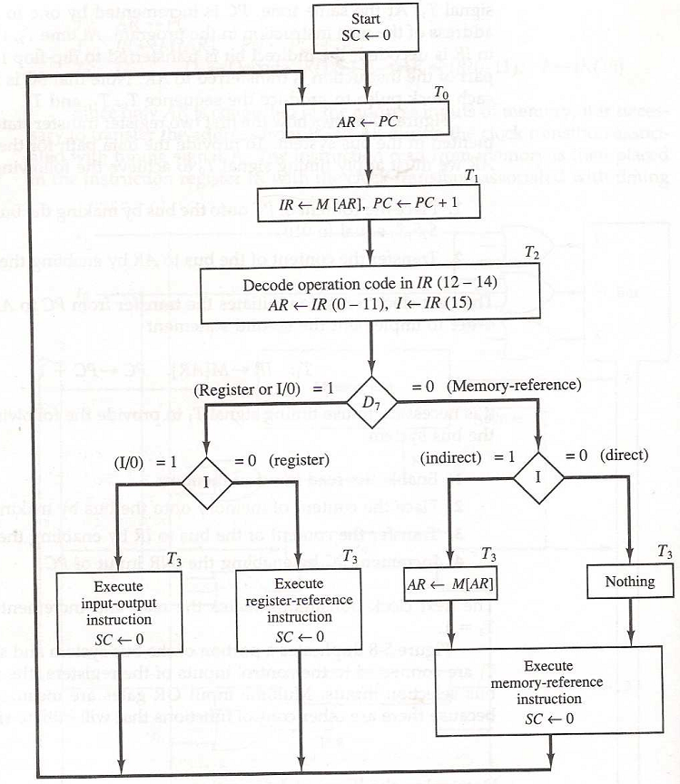
Determine the Type of Instruction
The flowchart shows the initial configurations for the instruction cycle and also how the control determines the instruction cycle type after the decoding.
Fig: Flowchart for instruction cycle

Slide 35
Determine the Type of Instruction
The timing signal that is active after the decoding is T₃.
During time T₃, the control unit determine the type of instruction that was read from the memory.
Fig: Flowchart for instruction cycle

Slide 36
Determine the Type of Instruction
If D₇=1, the instruction must be a register-reference or input-output type.
If D₇ = 0, the instruction must be a memory-reference instruction.
Fig: Flowchart for instruction cycle

Slide 37
Determine the Type of Instruction
when D₇ = 0, the operation code must be one of the other seven values 000 through 110.
Fig: Flowchart for instruction cycle

Slide 38
Determine the Type of Instruction
Control then inspects the value of the first bit of the instruction, which is now available in flip-flop I.
Fig: Flowchart for instruction cycle

Slide 39
Determine the Type of Instruction
If D₇ = 0 and I = 1, indicates a memory-reference instruction with an indirect address. So it is then necessary to read the effective address from memory.
Fig: Flowchart for instruction cycle

Slide 40
Determine the Type of Instruction
If D₇ = 0 and I = 0, indicates a memory-reference instruction with a direct address.
Fig: Flowchart for instruction cycle

Slide 41
Determine the Type of Instruction
If D₇ = 1 and I = 0, indicates a register-reference instruction.
If D₇ = 1and I = 1, indicates an input-output instruction.
Fig: Flowchart for instruction cycle

Slide 42
Determine the Type of Instruction
The three instruction types are subdivided into four separate paths.
The selected operation is activated with the clock transition associated with timing signal T₃.
Fig: Flowchart for instruction cycle

Slide 43
Determine the Type of Instruction
Symbolized:-
D'7IT3: AR ← M[AR]
D'7I'T3: Nothing
D7I'T3: Execute a register-reference instr.
D7IT3: Execute an input-output instr.
Fig: Flowchart for instruction cycle

Slide 44
Determine the Type of Instruction
A register-reference or input-output instruction can be executed with the clock associated with timing signal T₃.
Fig: Flowchart for instruction cycle

Slide 45
Determine the Type of Instruction
The execution of the memory-reference instruction can be continued with timing variable T₄, when instruction with I=0.
Fig: Flowchart for instruction cycle

Slide 46
Determine the Type of Instruction
After the instruction is executed, SC is cleared to 0 and control returns to the fetch phase with T₀=1.

Slide 47
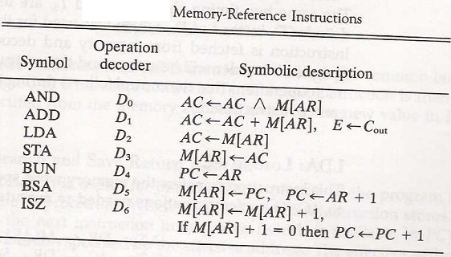
Memory-reference instruction

Slide 48
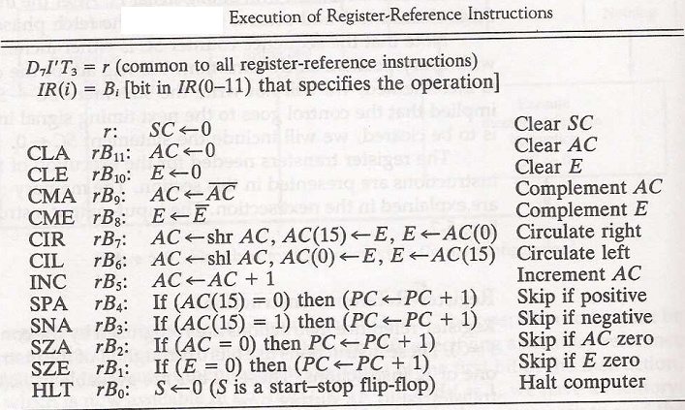
Register-reference instruction

Slide 49
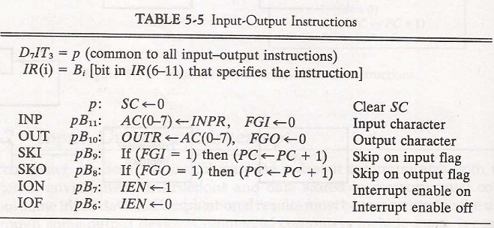
Input-output instruction

